Slide 1

Coupled Groundwater/Surface-Water Modeling using GSFLOW ID2447 October 7-11, 2019 BLM-CA Multi-Use Conference Room, 2800 Cottage Way, Sacramento, CA

Slide 2

USGS California Water Science centeR

Slide 3
California state water control board and other participants

Slide 4
Instructors Ayman Alzraiee, California water science center Eric morway, Nevada water science center Rich Niswonger, Water mission area, California Steve Regan, water mission area, Colorado

Slide 5
Class agenda at Thirty thousand feet
Day 1: PRMS, MODFLOW, GSFLOW overview (PowerPoint)
Day 2: Building models, developing workflow (GSFLOW-Arcpy, pyGSFLOW, Notebooks), output processing
Day 3: Calibration (pyGSFLOW, PowerPoint, Notebooks), Post processing
Day 4: MODSIM-GSFLOW, Small working groups
Day 5: Class projects

Slide 6
Course objectives
Provide purpose, capabilities, and theory of GSFLOW
Present conceptual approach for building models
Provide demonstration of tools (Jupyter Notebooks, ArcMap and Arcpy, PRMS GUI)
Introduce work flow
Make Progress on individual GSFLOW applications through class project

Slide 7

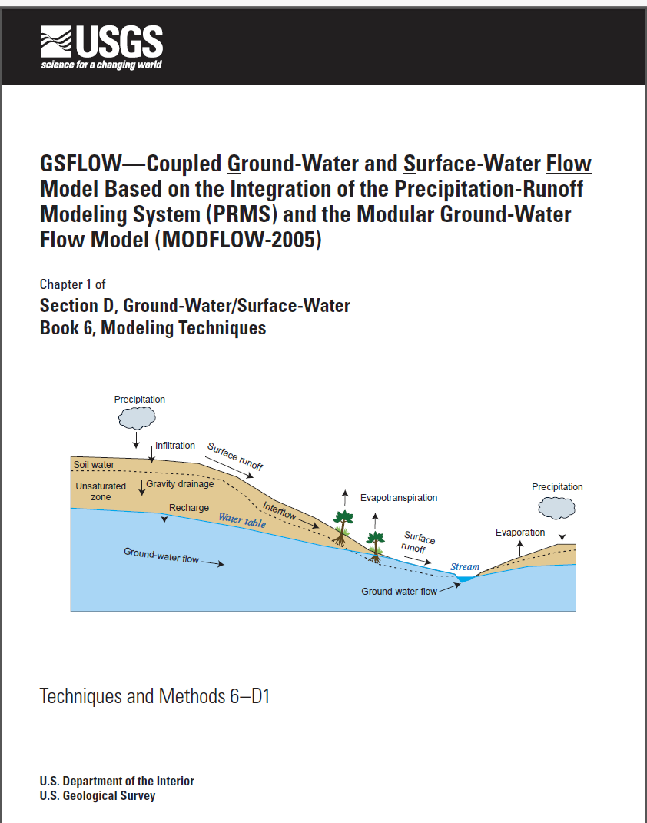
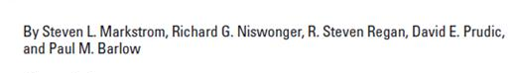
GSFLOW
Integrated hydrologic model
Supply limited and demand driven water use
Regional scale water resources analysis

Slide 8
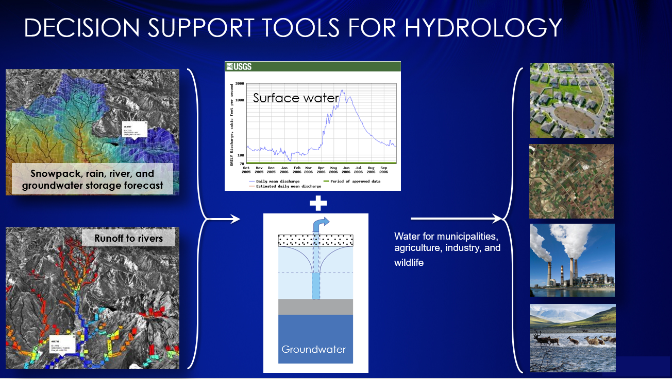

Slide 9
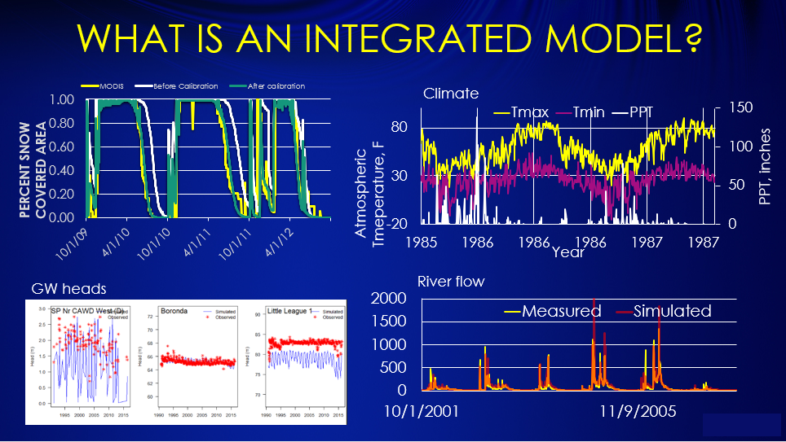

Slide 10
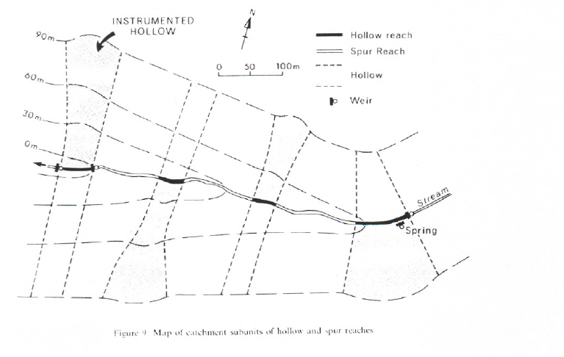
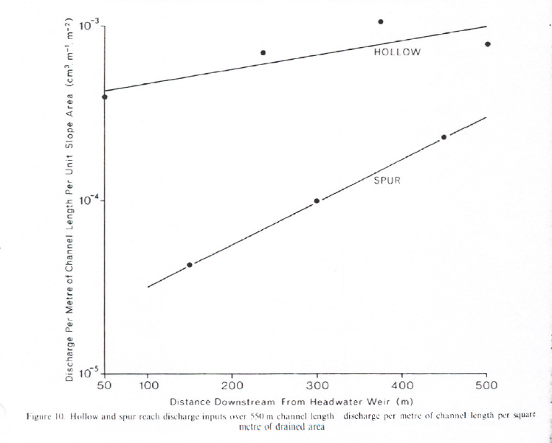
Shallow lateral flow
Anderson and Burt, 1978
Converging (“hollow”) verses diverging (“Spur”) flow
hollow
spur

Slide 11
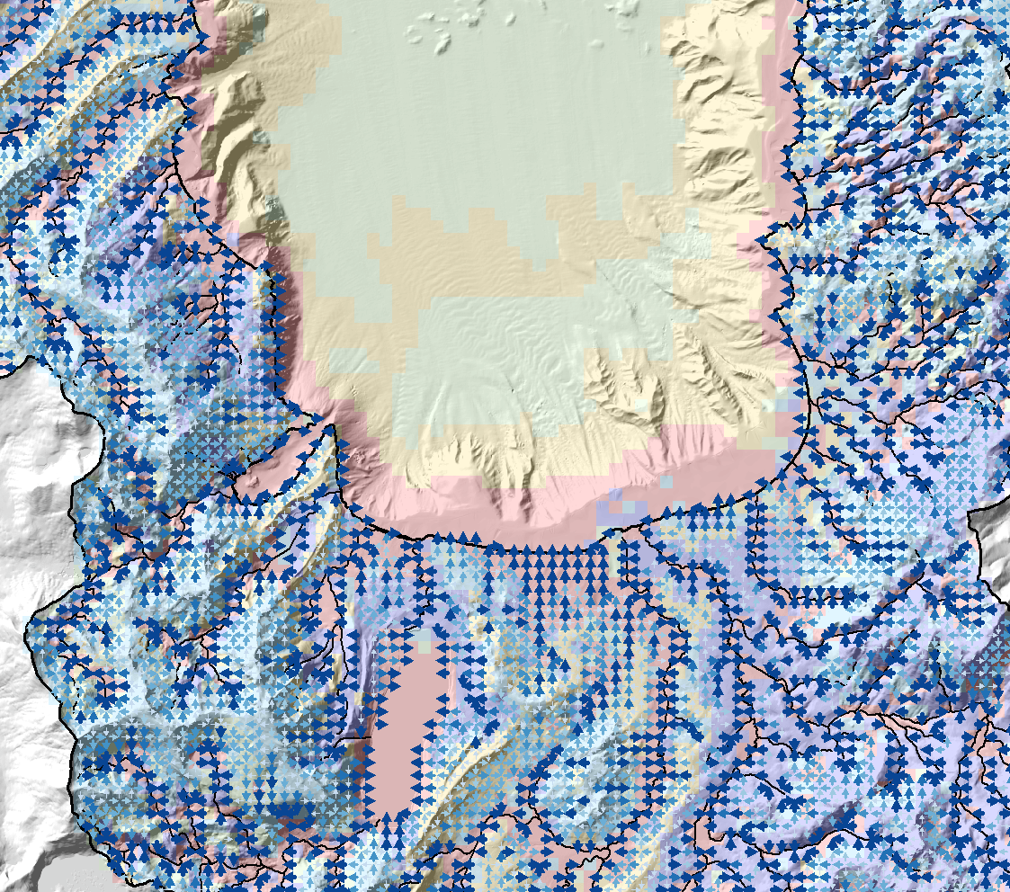
cascades
Lateral flows routed according to topography and topology
Cascades determined using Cascade Routing Tool (Henson and others, 2013)

Slide 12
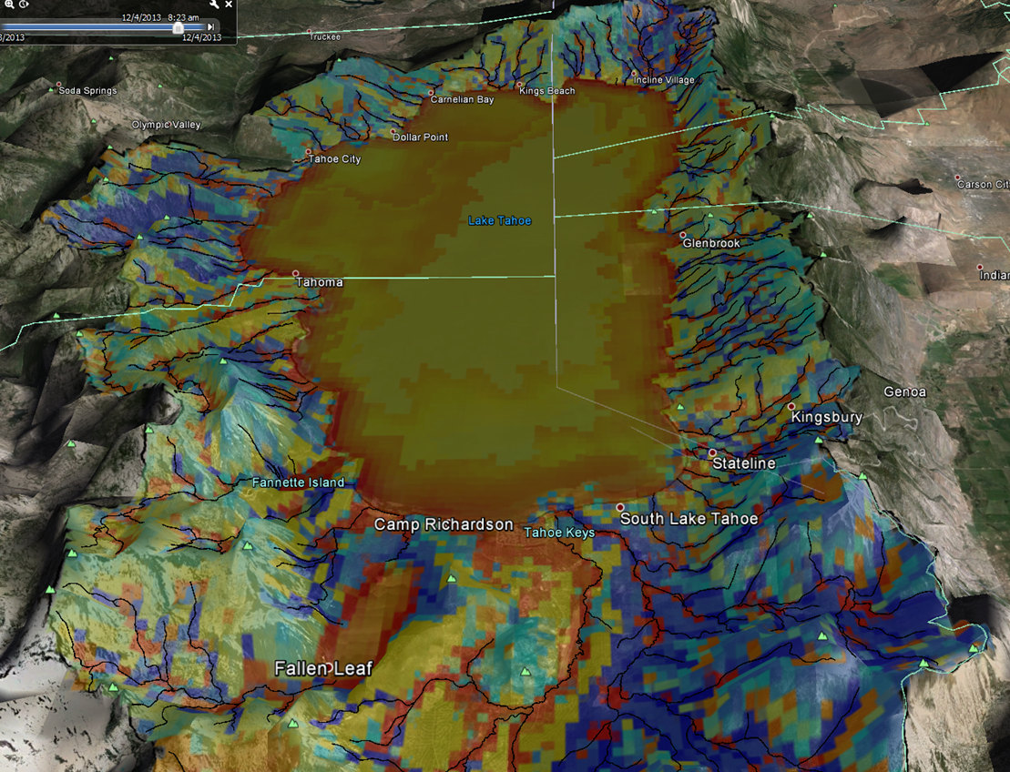
Simulated recharge/discharge
Red-GW discharge
Blue-GW recharge
Gold-Zero

Slide 13
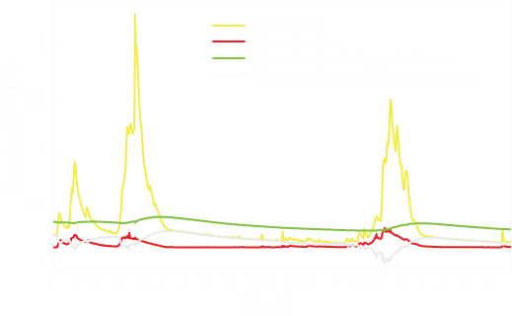
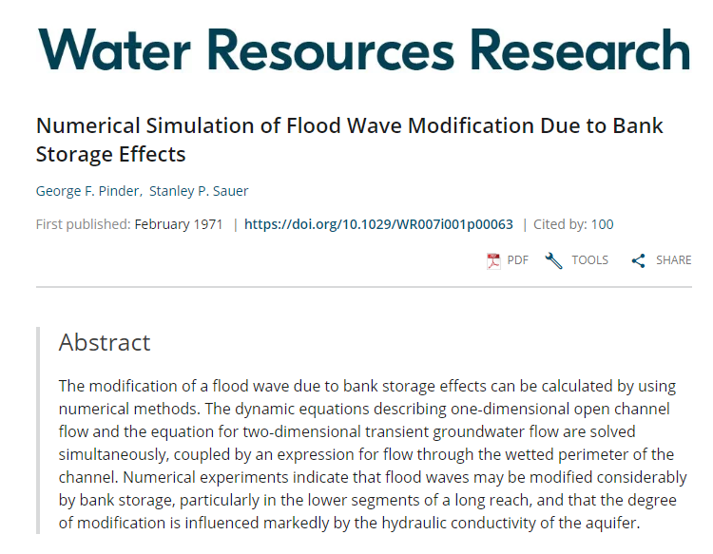
Huntington and Niswonger, 2012

Slide 14

What to expect
Lots of hydrology, modeling, and software concepts
Solid first day of PowerPoint to lay out modeling concepts
Second and third days of Notebooks illustrating work flow and class exercises
Forth day working on class project

